Slide 1

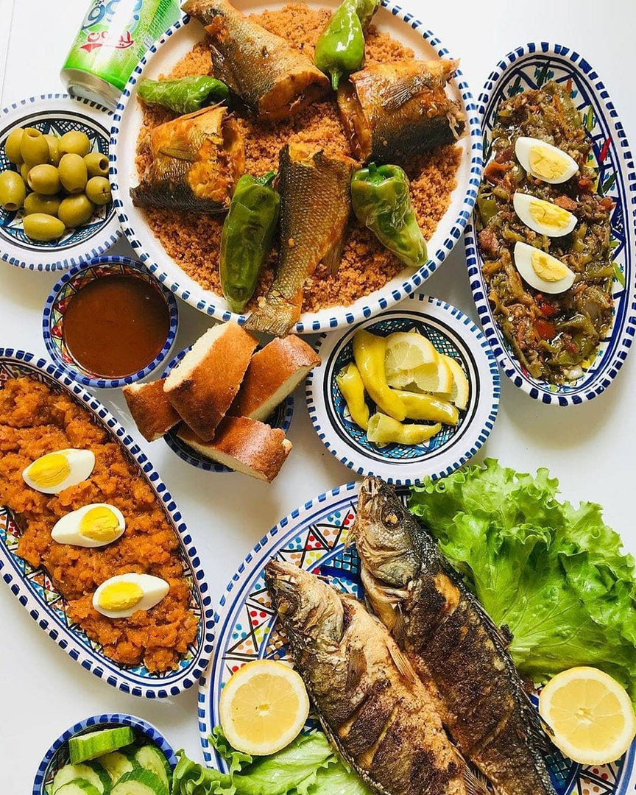
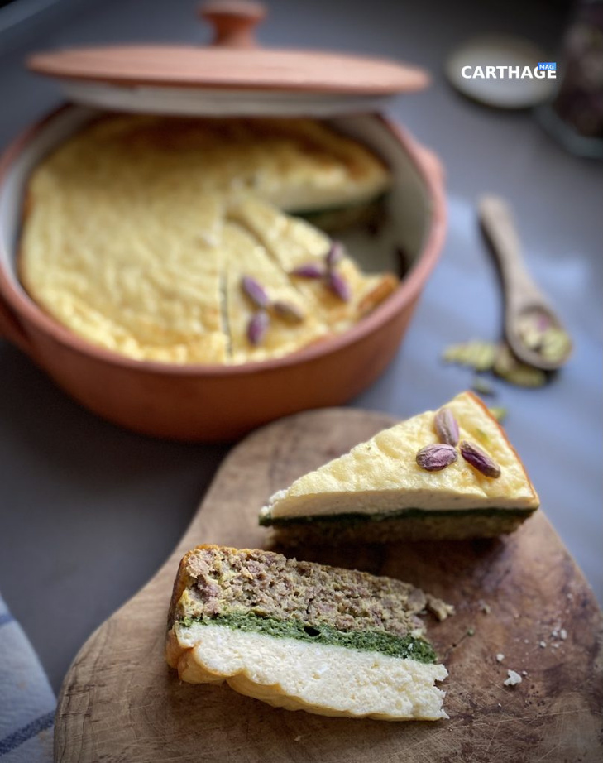

Duo Project
Tunisiacuisine
Recepies website
Rahma Aliani
Mohamed Chokri

Slide 2
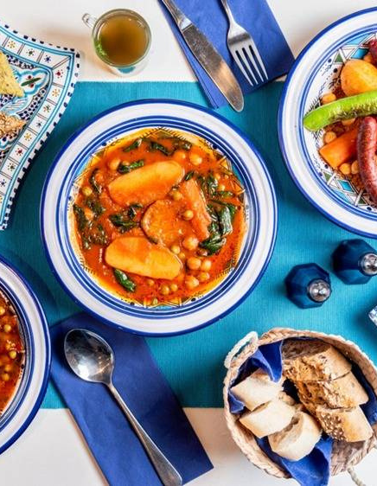

Table of
Content
Introduction
Reason
Demo
Challenges faced
Lessons learned
Conclusion

Slide 3
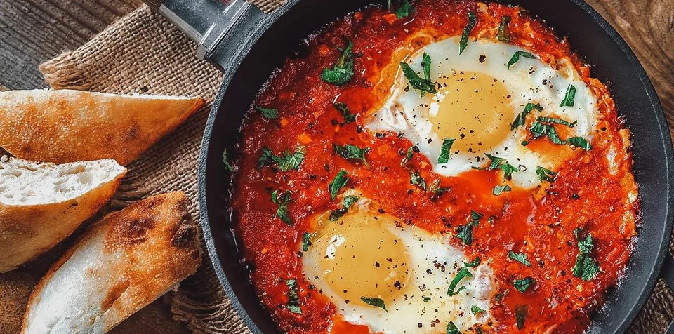
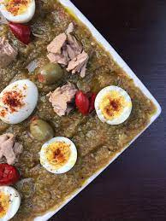

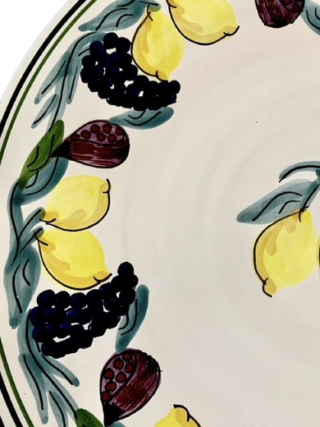
Introduction
Hi! Welcome to Our Tunisian Table, a place where we share recipes, stories, and traditions from North Africa. We're Rahma and Mohamed Chokri, future full stack developers.
our journey today will be focused on “We eat first with our eyes”
.............................................................
We are so excited today to combine our knowledge from our previous solo project into a duo project
so we hope Our combined work will be a useful resource for you.
Enjoy!

Slide 4
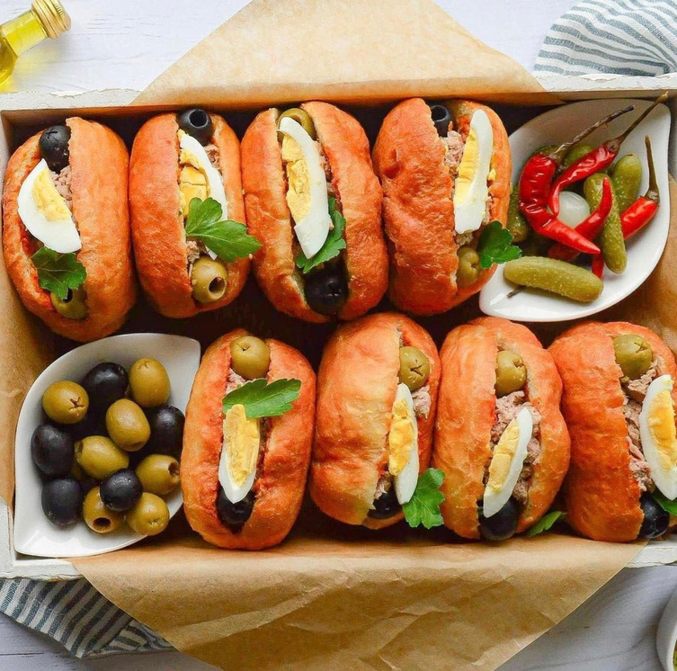
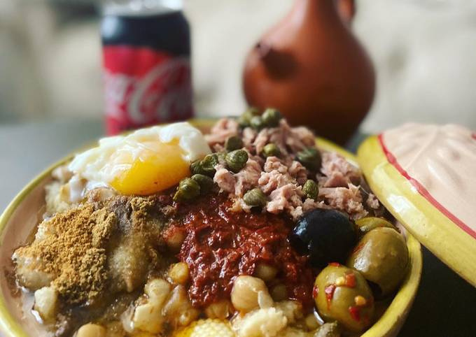
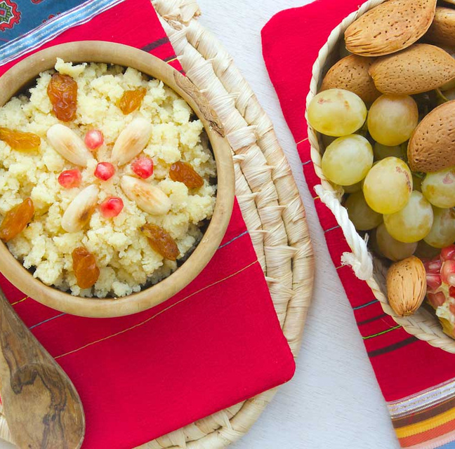

we
love
food
Most of our cooking website are in French, so we try to create an easy website to reach further more.
Reason
With this website, everyone will be able to have the fancy of tunisian’s food journey in his own house

Slide 5
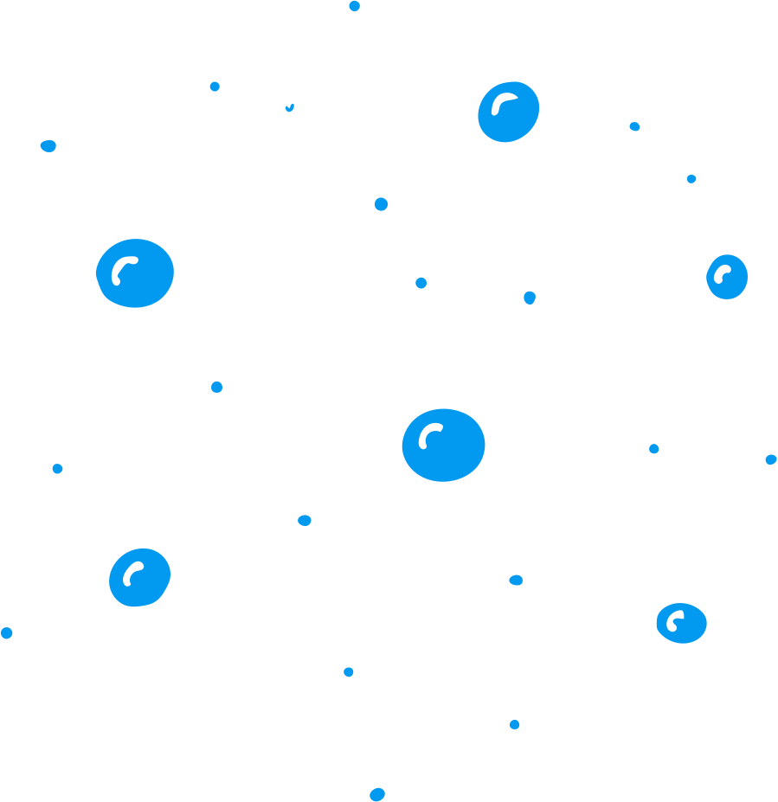
Demo

Slide 6
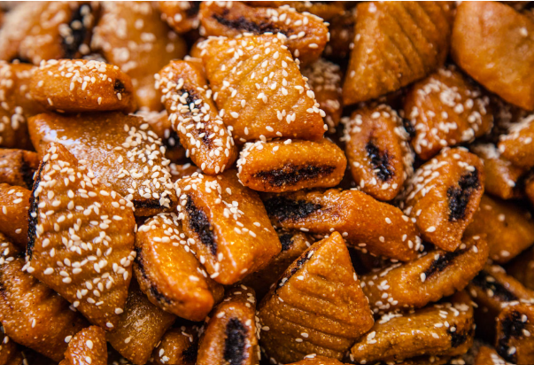
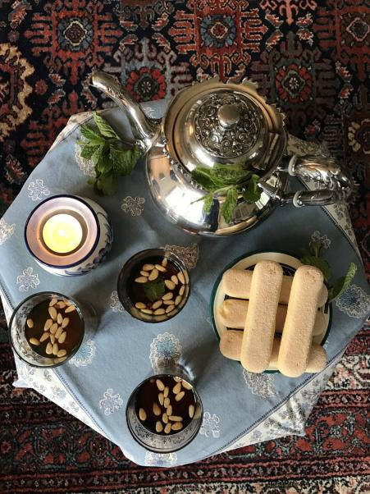
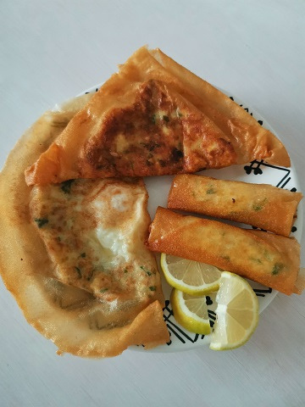

Challenges faced
Presentations are communication tools that can be used as demonstrations, lectures,

Slide 7
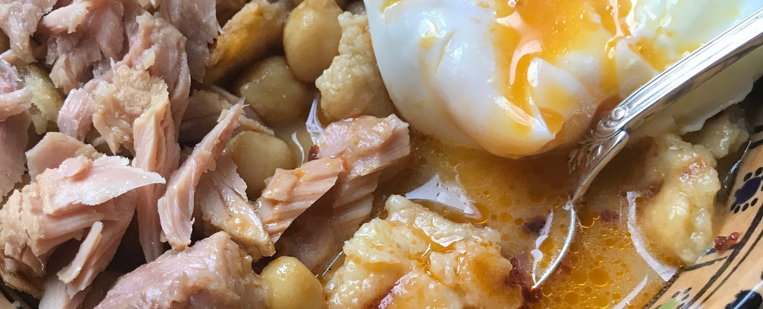
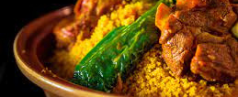
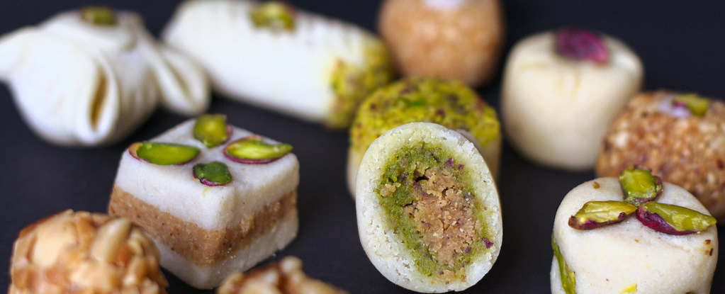
Lessons learned
Presentations are communication tools that can be used as demonstrations, lectures,

Slide 8
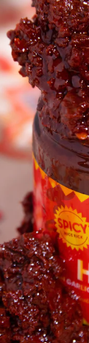
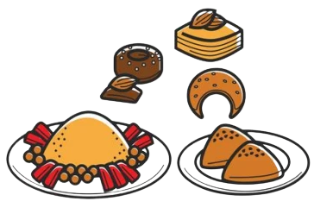
Conclusion
Presentations are communication tools that can be used as demonstrations, lectures,

